Slide 1


Revolutionize your music with Harmonic Split's A.I. instrument separation and guitar tuning technology.
Frimu Aurel-Viorel
Nisipeanu Ionut

Slide 2
1. Introduction
2. The need for harmonic split
3. Technical Details
4. Features
5. Use cases
6. Conclusion

Slide 3
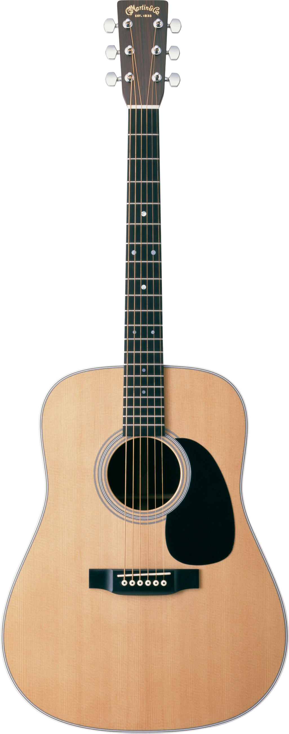
1.Introduction
What
What is
Technologies did we use?
?

Slide 4
3. Technical Details
Challenges faced by musicians:
How Harmonic Split Solves These Challenges:
Difficulty in tuning guitars accurately
Time-consuming process of separating individual instruments in a song
Limited resources and tools available to musicians
Lack of access to specialized software and equipment
Harmonic Split uses A.I. and signal processing to solve guitar tuning and track separation challenges.
Users can easily tune guitars and split audio into multiple tracks, such as vocals, bass, and piano.
Harmonic Split provides an intuitive interface and real-time feedback for easy and accurate use.

Slide 5
3.Technical Details
We use ngrok to expose the local server for public access during development and implement a queue system to manage long-running tasks.
We utilize Artificial Intelligence (A.I.) through the integration of Spleeter, an open-source library used to separate audio tracks in a song.
Harmonic Split is built using Flask, HTML, CSS, JS, Jinja2, AJAX, and Python.

Slide 6
Live Demonstration

Slide 7
6. Conclusion
Harmonic Split is an innovative web app that provides accurate guitar tuning and track separation using A.I.
Future updates and improvements will include a new A.I model to detect chords from audio files, a YouTube scraper to split directly from YouTube, and audio conversion features.
Try out Harmonic Split at https://rb.gy/9kf2b and provide feedback to help us improve.

